Slide 1
Chapter 2
Digital Design and Computer Architecture, 2nd Edition
David Money Harris and Sarah L. Harris

Slide 2

课程回顾
数字系统和数字设计
逻辑门
数制
数字电路的基础
布尔代数
开关函数
开关电路
数字电路基础知识（逻辑门的实现）
二极管
TTL
CMOS
2

Slide 3
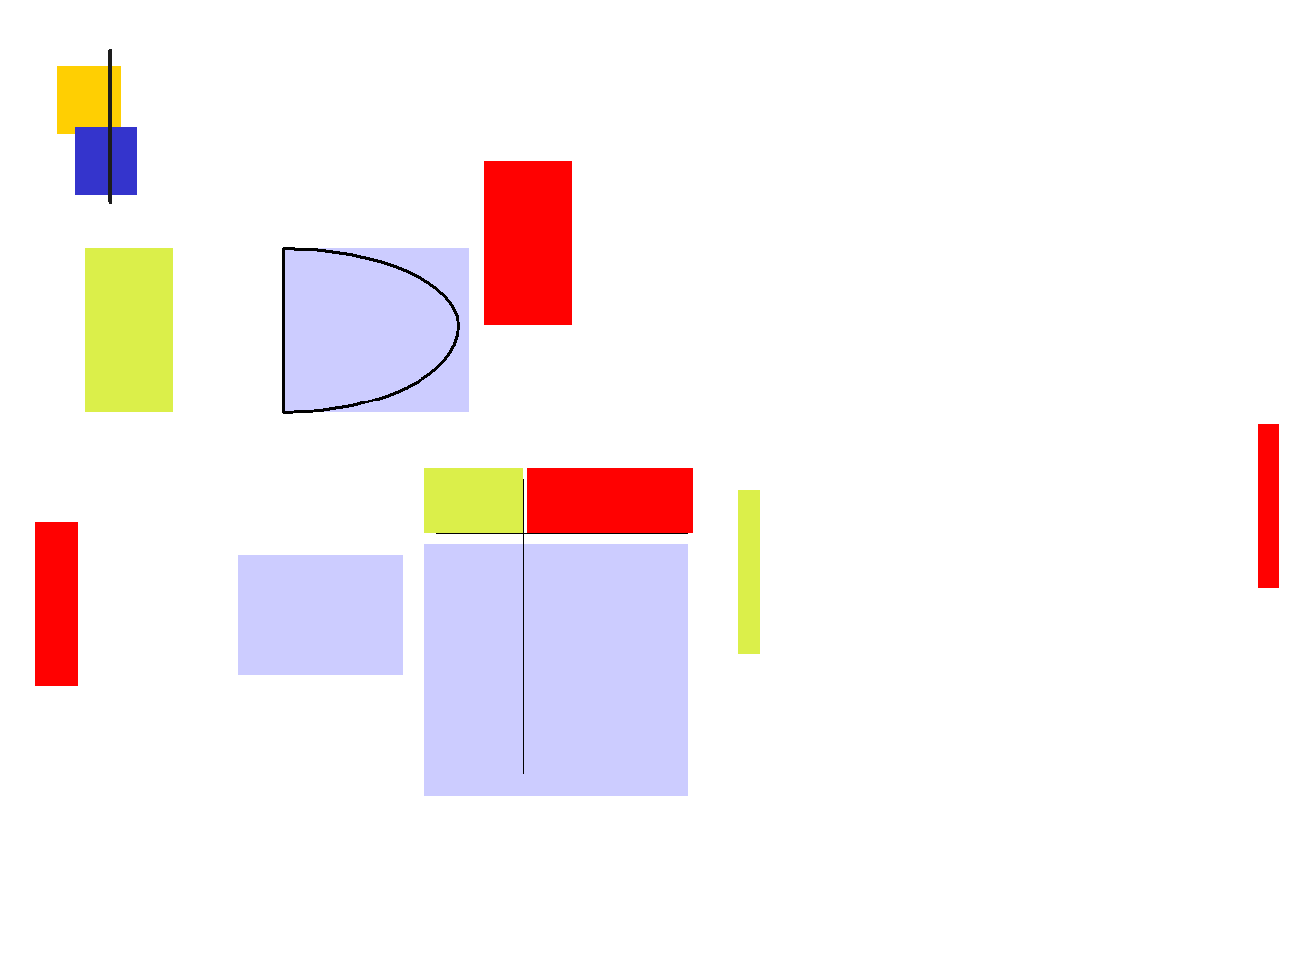

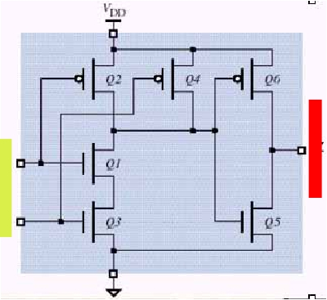
课程回顾：基础部分总结
逻辑门
Z=f (X, Y)
X
Y
XY
f ( X , Y )
Z
X
00
01
0
0
f ( X , Y ) = X ● Y
Y
10
0
开关函数
11
1
CMOS实现
真值表
3

Slide 4
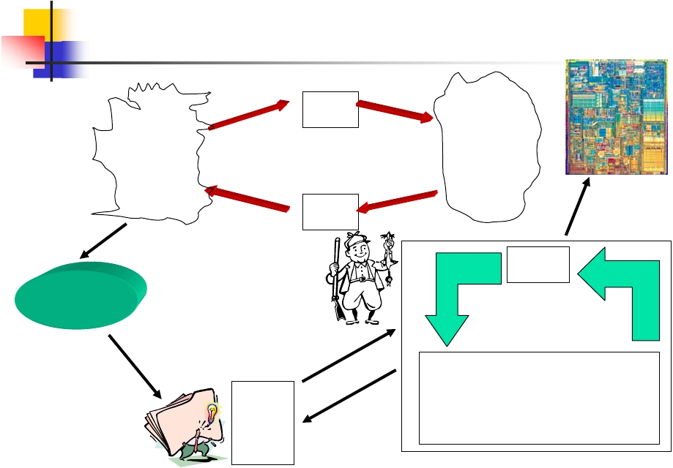
分析与设计
A/D
数
字 编
世 码
模
拟
世
界
D/A
界
实现
存储
应用问题
数字系统
设计
分析
输入 门级网络 输出
•组合电路
•时序电路
设计者
• 知识
• 方法
分析
• 工具
4

Slide 5
电路分析与设计
电路设计：从一个电路功能的描述到一
组开关函数进而到门级、PLD或其它逻辑
单元实现的转化过程。
电路分析：从一个数字电路的实现出
发，得到电路的某种形式的功能描述
开关表达式(Switch expression)
真值表(Truth table)
时序图(Timing diagram)
其它行为描述(behavioral description)
设计与分析是相反的过程
数字逻辑——组合电路（一）
5

Slide 6
电路分析与设计
电路设计：从一个电路功能的描述到一
组开关函数进而到门级、PLD或其它逻辑
单元实现的转化过程。
电路分析：从一个数字电路的实现出
发，得到电路的某种形式的功能描述
开关表达式(Switch expression)
真值表(Truth table)
时序图(Timing diagram)
其它行为描述(behavioral description)
设计与分析是相反的过程
5
Notes:
PLD是可编程逻辑器件

Slide 7
电路分析的目的
确定逻辑电路的行为功能
验证电路的行为和规范说明是否一致
协助将电路转变为另一种形式
减少电路中门的个数
采用不同的逻辑单元实现电路
获取前人电路设计的知识、方法和经验
6

Slide 8
组合电路和时序电路
组合电路
输出是输入的逻辑函数
输入变化一定时间后出现相应的输出
电路中没有循环反馈 (feedback loop)和时钟
(Clock)信号
时序电路
输出是输入和电路的历史输入序列的函数
输入变化后新的输出出现在下一个时钟周期
有循环反馈电路
7

Slide 9

组合电路和时序电路
时序电路是组合电路加上存储部件
X
Y
X
Y
门级网络
组合电路
存储
组合电路
时序电路
8

Slide 10
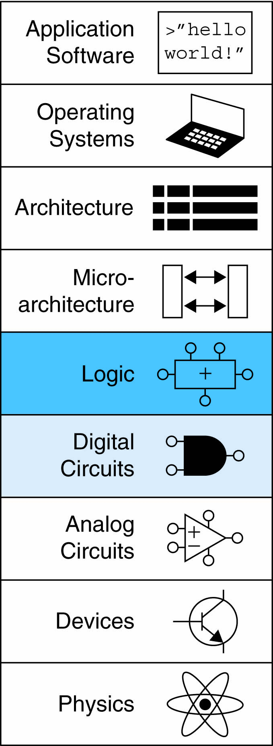
Chapter 2 :: Topics
Introduction
Boolean Equations
Boolean Algebra
From Logic to Gates
Multilevel Combinational Logic
X’s and Z’s, Oh My
Karnaugh Maps
Combinational Building Blocks
Timing

Slide 11
Introduction
A logic circuit is composed of:
Inputs
Outputs
Functional specification功能规范
Timing specification时序规范
- 功能规范
- 时序规范

Slide 12
Circuits
Nodes
Inputs: A, B, C
Outputs: Y, Z
Internal: n1
Circuit elements
E1, E2, E3
Each a circuit
图2-2
在黑盒内部，电路由一些节点和组件组成。组件本身又是一个带有输入、输出、功能规范和时序规范的电路。节点是一段导线，它通过电压传递离散变量。

Slide 13
Types of Logic Circuits
Combinational Logic组合逻辑
Memoryless没有记忆
Outputs determined by current values of inputs
输出仅仅取决于输入的值
Sequential Logic时序逻辑
Has memory有记忆
Outputs determined by previous and current values of inputs输出取决于当前输入值和之前的输入值

Slide 14
Rules of Combinational Composition
Every element is combinational每一个电路组件本身都是组合电路
Every node is either an input or connects to exactly one output每一个电路节点或者是一个电路的输出，或者仅仅连接到一个电路组件的一个输出端口
The circuit contains no cyclic paths电路不能包含回路
Example（例2.1）:

Slide 15
Boolean Equations布尔表达式
Functional specification of outputs in terms of inputs
Example: S = F(A, B, C_{in})
C_{out} = F(A, B, C_{in})
图2-5 全加器
异或门

Slide 16
Some Definitions
Complement: variable with a bar over it补
A, B, C
Literal: variable or its complement
A, A, B, B, C, C
Implicant: product of literals蕴涵项
ABC, AC, BC
Minterm: product that includes all input variables最小项
ABC, ABC, ABC
Maxterm: sum that includes all input variables最大项
(A+B+C), (A+B+C), (A+B+C)

Slide 17
Sum-of-Products (SOP) Form与或式
中文书，2.2.2节
All equations can be written in SOP form
Each row has a minterm
A minterm is a product (AND) of literals
Each minterm is TRUE for that row (and only that row)
Form function by ORing minterms where the output is TRUE
Thus, a sum (OR) of products (AND terms)
真值表和最小项
Y = F(A, B) =

Slide 18
Sum-of-Products Form
Sum-of-Products (SOP) Form
All equations can be written in SOP form
Each row has a minterm
A minterm is a product (AND) of literals
Each minterm is TRUE for that row (and only that row)
Form function by ORing minterms where the output is TRUE
Thus, a sum (OR) of products (AND terms)
Y = F(A, B) =

Slide 19
Sum-of-Products Form
Sum-of-Products (SOP) Form
All equations can be written in SOP form
Each row has a minterm
A minterm is a product (AND) of literals
Each minterm is TRUE for that row (and only that row)
Form function by ORing minterms where the output is TRUE
Thus, a sum (OR) of products (AND terms)
Y = F(A, B) = AB + AB = Σ(1, 3)

Slide 20
Product-of-Sums (POS) Form或与式
中文书，2.2.3节
All Boolean equations can be written in POS form
Each row has a maxterm
A maxterm is a sum (OR) of literals
Each maxterm is FALSE for that row (and only that row)
Form function by ANDing the maxterms for which the output is FALSE
Thus, a product (AND) of sums (OR terms)
Y = F(A, B) = (A + B)(A + B) = Π(0, 2)

Slide 21
Boolean Equations Example
自助餐厅
You are going to the cafeteria for lunch
You won’t eat lunch (E)
If it’s not open (O) or
If they only serve corndogs (C)
Write a truth table for determining if you will eat lunch (E).
玉米“热狗”

Slide 22
Boolean Equations Example
You are going to the cafeteria for lunch
You won’t eat lunch (E)
If it’s not open (O) or
If they only serve corndogs (C)
Write a truth table for determining if you will eat lunch (E).
看中文书 例2.2更好

Slide 23
Boolean Algebra布尔代数
公理和定理
Axioms and theorems to simplify Boolean equations
Like regular algebra, but simpler: variables have only two values (1 or 0)
Duality in axioms and theorems:
ANDs and ORs, 0’s and 1’s interchanged
对偶原理

Slide 24
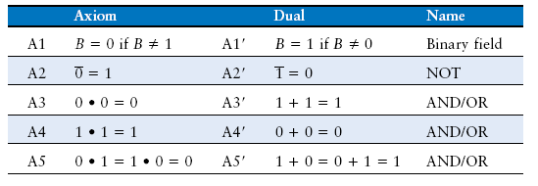
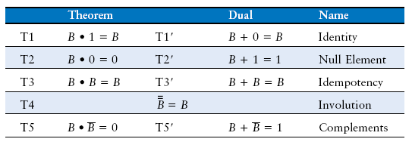
Boolean Axioms公理
表2-1
表2-2

Slide 25
T1: Identity Theorem同一性定理
B 1 = B
B + 0 = B

Slide 26
T1: Identity Theorem
B 1 = B
B + 0 = B
图2-14 同一性定理的硬件解释

Slide 27
T2: Null Element Theorem零元定理
B 0 = 0
B + 1 = 1

Slide 28
T2: Null Element Theorem
B 0 = 0
B + 1 = 1
图2-15 零元定理的硬件解释

Slide 29
T3: Idempotency Theorem重叠定理
B B = B
B + B = B

Slide 30
T3: Idempotency Theorem
B B = B
B + B = B
图2-16 重叠定理的硬件解释

Slide 31
T4: Involution Theorem回旋定理
B = B

Slide 32
T4: Involution Theorem
B = B
图2-17 回旋定理的硬件解释

Slide 33
T5: Complement Theorem互补定理
B B = 0
B + B = 1

Slide 34
T5: Complement Theorem
B B = 0
B + B = 1
图2-18 互补定理的硬件解释

Slide 35
Boolean Theorems Summary
表2-2 单变量的布尔代数定理

Slide 36
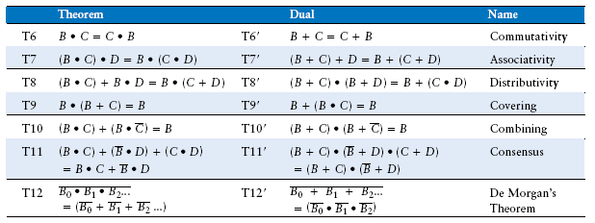
Boolean Theorems of Several Vars
表2-3 含多个变量的布尔定理
- 交换律
- 结合律
- 分配律
- 吸收律
- 合并律
- 一致律
- 摩根定律

Slide 37
Simplifying Boolean Equations
Example 1:
Y = AB + AB

Slide 38
Simplifying Boolean Equations
Example 1:
Y = AB + AB
= B(A + A) T8
= B(1) T5’
= B T1

Slide 39
Simplifying Boolean Equations
Example 2:
Y = A(AB + ABC)

Slide 40
Simplifying Boolean Equations
Example 2:
Y = A(AB + ABC)
= A(AB(1 + C)) T8
= A(AB(1)) T2’
= A(AB) T1
= (AA)B T7
= AB T3

Slide 41
DeMorgan’s Theorem
Y = AB = A + B
Y = A + B = A B
图2-19 摩根定理的等价电路，中文书p38

Slide 42
Bubble Pushing推气泡的规则
Backward:
Body changes
Adds bubbles to inputs
Forward:
Body changes
Adds bubble to output
向后推输出端的气泡或者向前推输入端的气泡，需要将与门换成或门，反之亦然
从输出端推气泡到输入端，把气泡放置在门的输入端
从门的所有输入端向前推气泡，把气泡放置在门的输出端

Slide 43
Bubble Pushing
What is the Boolean expression for this circuit?

Slide 44
Bubble Pushing
What is the Boolean expression for this circuit?
Y = AB + CD

Slide 45
Bubble Pushing Rules
见中文书p38
Begin at output, then work toward inputs
Push bubbles on final output back
Draw gates in a form so bubbles cancel

Slide 46
Bubble Pushing Example

Slide 47
Bubble Pushing Example

Slide 48
Bubble Pushing Example

Slide 49
Bubble Pushing Example

Slide 50
From Logic to Gates从逻辑到门
Two-level logic: ANDs followed by ORs
Example: Y = ABC + ABC + ABC
图2-23 电路原理图

Slide 51
Circuit Schematics Rules电路原理图规则
Inputs on the left (or top)
输入在原理图的左边或者顶部
Outputs on right (or bottom)
输出在原理图的右边或者顶部
Gates flow from left to right
门必须从左输入、从右输出
Straight wires are best
最好使用直线而不是使用有很多拐角的线

Slide 52
Circuit Schematic Rules (cont.)
Wires always connect at a T junction走线总是在T交叉点连接
A dot where wires cross indicates a connection between the wires在两条线交叉的地方有一个点，表示它们之间有连接
Wires crossing without a dot make no connection没有点，表示它们没有连接
图2-24 线的连接

Slide 53
Multiple-Output Circuits多输出电路
例2.7 多输出电路
Example: Priority Circuit
Output asserted
corresponding to
most significant
TRUE input
优先级电路

Slide 54
Multiple-Output Circuits
Example: Priority Circuit
Output asserted
corresponding to
most significant
TRUE input

Slide 55
Priority Circuit Hardware

Slide 56
Don’t Cares
图2-29 带有无关项（X）的优先级电路真值表

Slide 57
Floating: Z浮空值Z
中文书p45，2.6.2节
高阻态
Floating, high impedance, open, high Z
Floating output might be 0, 1, or somewhere in between
A voltmeter won’t indicate whether a node is floating
Tristate Buffer
伏特表/电压表
图2-40 三态缓冲器

Slide 58
Tristate Busses三态总线
Floating nodes are used in tristate busses
Many different drivers
Exactly one is active at
once
图2-42 通过三态总线互连多个芯片

Slide 59
Karnaugh Maps (K-Maps)卡诺图
Boolean expressions can be minimized by combining terms
K-maps minimize equations graphically
PA + PA = P
卡诺图是一个图形化的化简布尔表达式方法
图2-43 三输入函数，真值表、卡诺图、卡诺图中的最小项

Slide 60
K-Map
画圈的原理
Circle 1’s in adjacent squares将值为1的相邻方格圈起来
In Boolean expression, include only literals whose true and complement form are not in the circle
Y = AB
图2-44 卡诺图化简

Slide 61
3-Input K-Map三输入卡诺图

Slide 62
3-Input K-Map
Y = AB + BC

Slide 63
K-Map Definitions
Complement: variable with a bar over it补
A, B, C
Literal: variable or its complement
A, A, B, B, C, C
Implicant: product of literals蕴含项
ABC, AC, BC
Prime implicant: implicant corresponding to the largest circle in a K-map主蕴含项

Slide 64
K-Map Rules卡诺图规则
见中文版 p48
Every 1 must be circled at least once
Each circle must span a power of 2 (i.e. 1, 2, 4) squares in each direction
Each circle must be as large as possible
A circle may wrap around the edges
A “don't care” (X) is circled only if it helps minimize the equation

Slide 65
4-Input K-Map 4输入卡诺图

Slide 66
4-Input K-Map

Slide 67
4-Input K-Map

Slide 68
K-Maps with Don’t Cares
带无关项的卡诺图

Slide 69
K-Maps with Don’t Cares

Slide 70
K-Maps with Don’t Cares

Slide 71
Combinational Building Blocks
中文书p51，2.8 组合逻辑模块
Multiplexers多路选择器
Decoders译码器

Slide 72
Multiplexer (Mux) 多路选择器
Selects between one of N inputs to connect to output从几个可能的输入中根据选择信号的值来选择一个作为输出
log₂N-bit select input – control input
Example: 2:1 Mux
多路选择器根据信号的值在2个输入数据中选择一个数据输出。

Slide 73
Multiplexer Implementations
多路选择器的实现
Logic gates
Sum-of-products form
Tristates 三态
For an N-input mux, use N tristates
Turn on exactly one to select the appropriate input
与或式
图2-56 使用三态缓冲实现2:1多路选择器

Slide 74
Logic using Multiplexers
用多路选择器实现逻辑
Using the mux as a lookup table查找表
图2-59 用一个4:1多路选择器实现二输入的与门

Slide 75
Logic using Multiplexers
用多路选择器实现逻辑
Reducing the size of the mux

Slide 76
Decoders译码器
N inputs, 2^{N} outputs 每个输出都取决于输入的组合
One-hot outputs: only one output HIGH at once
输出成为“独热”状态，在给定的条件下恰好只有一个输出为高电平
图2-63 2:4译码器

Slide 77
Decoder Implementation译码器实现
图2-64 2:4译码器实现，中文书p55

Slide 78
Logic Using Decoders用译码器实现逻辑
OR minterms
图2-65 使用译码器的逻辑函数，异或非门

Slide 79
Timing时序
Delay between input change and output changing 输出响应输入的改变而改变需要一定时间
How to build fast circuits?
如何使电路运行的最快
图2-66 电路延迟

Slide 80
Propagation & Contamination Delay
传输延迟和最小延迟，中文书p56
Propagation delay: t_{pd} = max delay from input to output
Contamination delay: t_{cd} = min delay from input to output
图2-67 传输延迟和最小延迟

Slide 81
Propagation & Contamination Delay
传输延迟和最小延迟
Delay is caused by
Capacitance and resistance in a circuit
Speed of light limitation
Reasons why t_{pd} and t_{cd} may be different:
Different rising and falling delays
Multiple inputs and outputs, some of which are faster than others
Circuits slow down when hot and speed up when cold
电路中电容充电所需要的时间和电信号以光速传播
不同的上升和下降延迟；
多个输入和输出之间的延迟可能有所不同；
当电路较热时速度会变慢，较冷时会变快。

Slide 82
Critical (Long) & Short Paths
最短路径和关键路径
Critical (Long) Path: t_{pd} = 2t_{pd_AND} + t_{pd_OR}
Short Path: t_{cd} = t_{cd_AND}
组合电路的传输延迟是关键路径上每一个元件的传输 延迟之和；最小延迟是在最短路径上每个元件的最小延迟之和。

Slide 83
Glitches毛刺
When a single input change causes multiple output changes
一个输入信号的改变可能会导致多个输出信号的改变

Slide 84
Glitch Example
What happens when A = 0, C = 1, B falls?
图2-75 产生毛刺的画圈方式

Slide 85
Glitch Example (cont.)
图2-76 产生毛刺的时序

Slide 86
Fixing the Glitch
图2-78 无毛刺的卡诺图
图2-79 无毛刺的电路

